Slide 1

Object-Oriented Programming
Using C++
Weiwei Xu
http://www.cad.zju.edu.cn/home/weiweixu/

Slide 2
Course Contents
Introduction to object-oriented programming…
…with a strong software engineering foundation…
…aimed at producing and maintaining large, high-quality software systems.

Slide 3
The Development of OOP
第一次软件危机：主要 体现在“复杂性”, 促进了结构化编程的大发展。
第二次软件危机：主要体现在“可扩展性”、“可维护性”上面。传统的面向过程(包括 结构化程序设计)方法已经越来越不能适应快速多变的业务需求了。面向对象的思想开始快速发展。

Slide 4
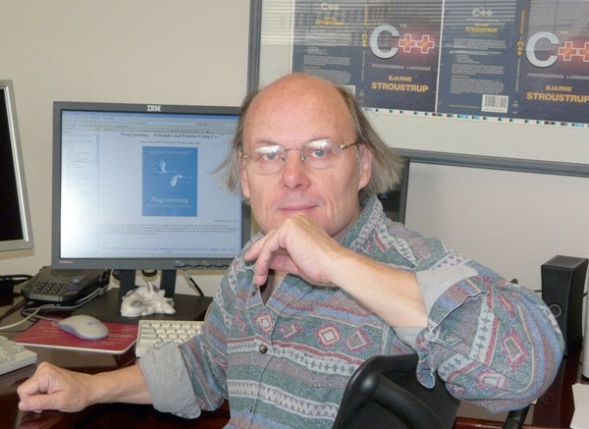
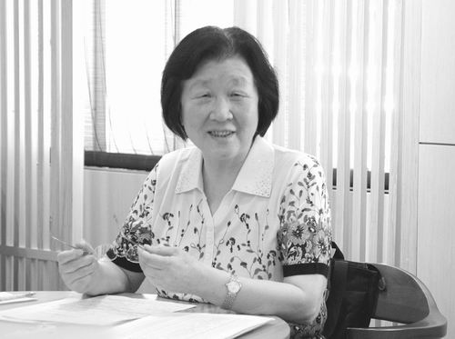
The Development of OOP
Bjarne Stroustrup
杨芙清院士
C++ was first designed and implemented by Bjarne Stroustrup, AT&T, early 1980’s
http://www.stroustrup.com/
合著了《面向对象的系统分析》《面向对象的系统设计》, 研制出基于构件—构架的应用系统集成组装环境,在北京2008年奥运会信息系统建模以及众多国家重大建设工程中得到广泛应用

Slide 5
Object-oriented programming
the programming tools are beginning to look less like machines and more like parts of our minds, and also like other expressive mediums such as writing, painting, sculpture, animation, and filmmaking. Object-oriented programming is part of this movement toward using the computer as an expressive medium.

Slide 6
Buzzwords
responsibility-driven design
Inheritance(继承)
Encapsulation (封装)
iterators
Polymorphism(多态)
coupling
interface
cohesion
overriding
template
collection classes
mutator methods
polymorphic method calls

Slide 7
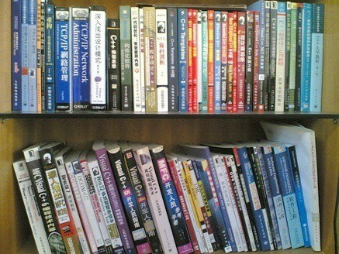
Textbooks

Slide 8
Textbooks
Thinking In C++, Ver. 2,Vol. 1 & 2
C++ Primer, Ver 5
References:
• The C++ Programming Language
• C++:The Core Language
• Essential C++
• Effective C++
• Inside the C++ Object Model
• C++ Templates

Slide 9
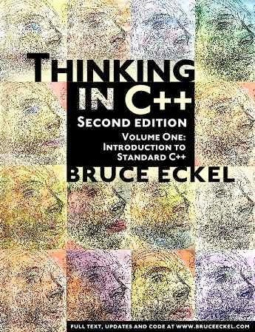
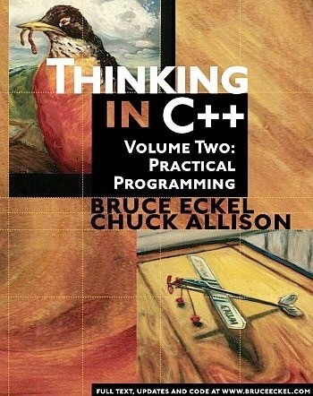
C++编程思想 机械工业出版社

Slide 10
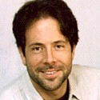
Bruce Eckel
BRUCE ECKEL is the author of “Thinking in C++”, which won the Software Development Jolt Award for best book of 1995. He's been professionally programming for 20 years and has been teaching people throughout the world how to program with objects since 1986. He was a voting member of the C++ Standards Committee.
http://mindview.net
6

Slide 11
Course Materials
面向对象编程2021-2022
课件PPT：
https://course.zju.edu.cn
作业：https://pintia.cn
习题集：面向对象程序设计2021-2022春夏习题集
用户组：面向对象程序设计2021-2022春夏习题集用户组, 邀请码：3b53d649a227b735

Slide 12
Assessment
1. Lab, 50%
! In week 2, 4, 6, 8, 10, 12, 14, 16.
To submit on-line, to be judged manually
Deadline is DEAD on Midnight of Sat.
2. Final exam: 50%, TBD

Slide 13
E-mail rule
xww@cad.zju.edu.cn
Title starts with “[OOP]”
State your name and sid in the text
Prefer plain text e-mail
NO background, music, color, font styles..

Slide 14
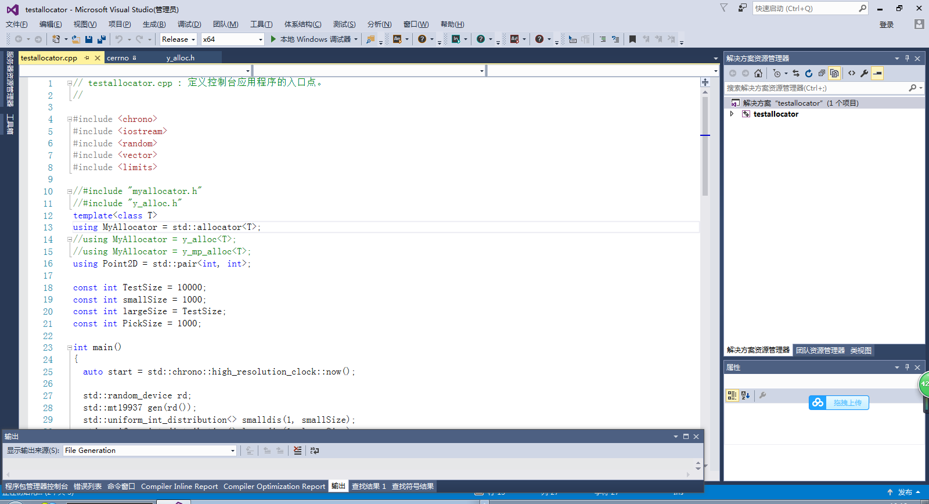
Tools for C++(1)
Microsoft Visual Studio 2015

Slide 15
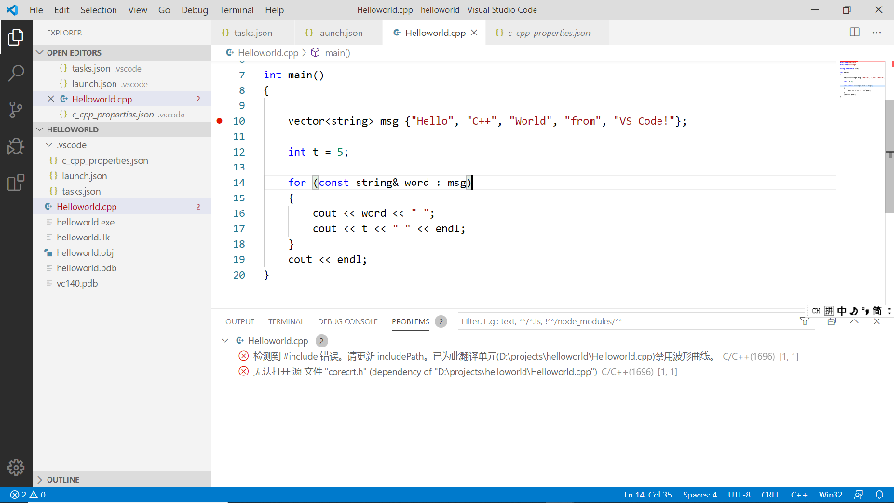
Tools for C++(1I)
Visual studio code –configure by yourself

Slide 16
The First C++ Program
#include <iostream> using namespace std;
int main()
{
cout << "Hello, World! I am “ << 18 << " Today!" << endl;
return 0;
}

Slide 17
Read input
#include <iostream> using namespace std;
int main() {
int number;
cout << "Enter a decimal number: "; cin >> number;
cout << "The number you entered is " << number <<"." << endl;
return 0;
}

Slide 18
Introduction to C++
The trip begins…

Slide 19
The C Language
Strengths
Efficient programs
Direct access to machine, suitable for OS and ES
Flexible
Weakness
Insufficient type checking
Poor support for programming-in-the-large
Procedure-oriented programming

Slide 20
Bjarne Stroustrup
C++ was first designed and implemented by Bjarne Stroustrup, AT&T, early 1980’s
http://www.stroustrup.com/

Slide 21
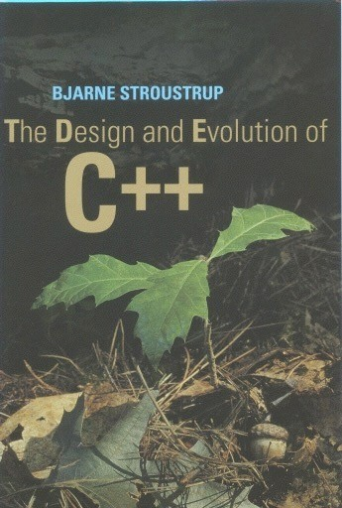
The Design and Evolution of C++
Bjarne Stroustrup, Addison-Wesley, ISBN 0-201-54330-3

Slide 22
C++ improvements
•
•
•
•
•
•
•
•
•
•
•
•
•
•
•
Data abstraction
References
Access control
Operator overloading
Initialization & cleanup
More safe and powerful memory management
Function overloading
Support for OOP
Streams for I/O
Templates
Constants (C99)
Exception handling
Name control
More extensive libraries, STL
Inline functions(C99)

Slide 23
C++ can be viewed as a “better”C
C++
• C++ => C=C+1
but...
C++ is not C
Focus on C++ as a language in its own right
C++ is a hybrid language, supports
Procedure-oriented programming
Object-oriented programming
Generic programming

